Slide 1
18CSC304J COMPILER DESIGN
UNIT 4
SESSIONS 11 & 12

Slide 2
Topics that will be covered
Basic Blocks & Flow Graphs (Unit 5 : Session 6(b) )
Next Use Information (Unit 5 : Session 7(a) )
A Simple Code Generator
Register and Address Descriptors
Code Generation Algorithm
Generating Code of Assignment Statements

Slide 3
BASIC BLOCKS & FLOW GRAPHS

Slide 4
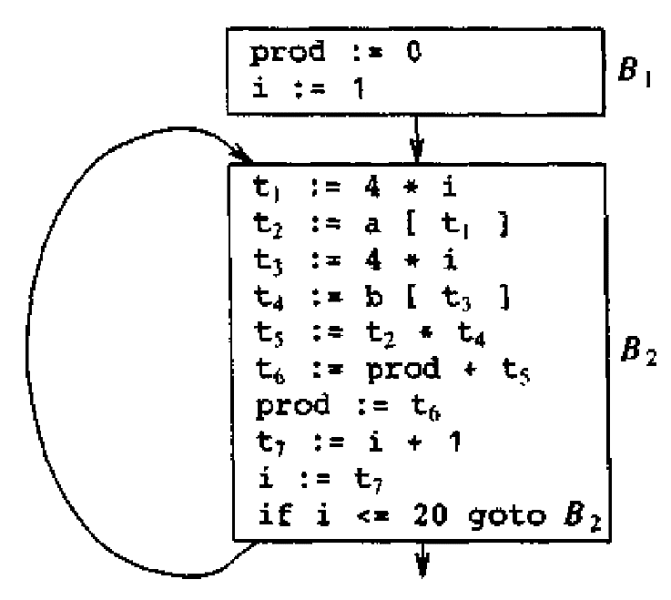
Basic Blocks & Flow Graphs
A graph representation of three-address statements, called a flow graph is useful for understanding code-generation algorithms
Nodes in the flow graph represent computations and the edges represent the flow of control

Slide 5
Basic Blocks
A basic block is a sequence of consecutive statements in which flow of control enters at the beginning and leaves at the end without halt or possibility of branching except at the end.
The following three-address statements forms a basic block
t1 := a * a
t2 := a * b
t3 := 2 * t2
t4 := t1 + t3
t5 := b * b
t6 := t4 + t5
A three-address statement x := y + z is said to define x and to use or reference y and z
A name in a basic block is said to be live at a given point if its value is used after that point in the program, perhaps in another basic block

Slide 6
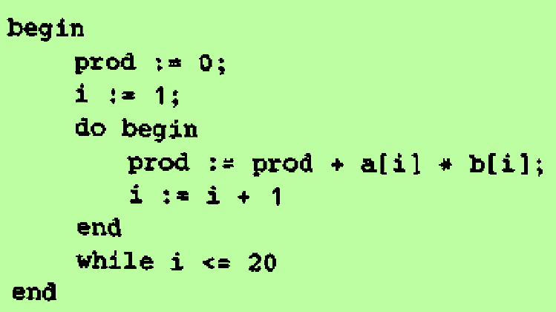
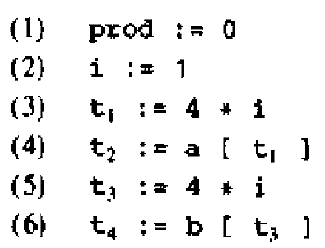
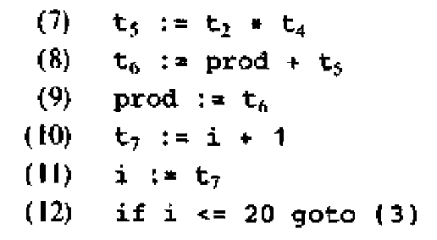
Algorithm: Partition a sequence of three-address statements into basic blocks
Determine the set of leaders, the first statement of basic blocks, using the rules
The first statement is a leader
Any statement that is a target of a conditional or unconditional goto is a leader
Any statement that immediately follows a goto or conditional goto statement is a leader
For each leader, its basic block consists of the leader and all statements upto but not including the next leader or the end of the program
Example:
Source Code: Three address code:

Slide 7
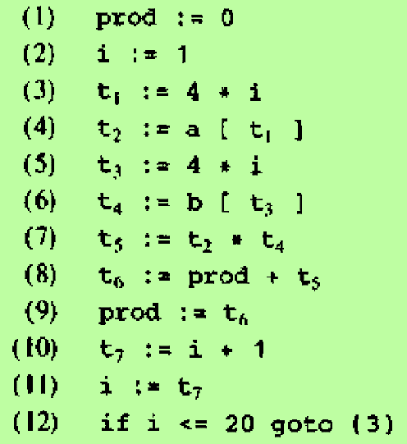
Basic Blocks
Statement (1) is a leader by rule (i)
Statement (3) is a leader by rule (ii)
Statement following (12) is a leader by rule (iii)
The basic blocks are
First basic block
Second basic block

Slide 8
Transformation on Basic Blocks
A basic block computes a set of expressions
Two basic blocks are said to be equivalent if they compute the same set of expressions
A number of transformations can be applied to a basic block without changing the set of expressions computed by the block
There are two types of transformations:
Structure-preserving transformations
Algebraic transformation

Slide 9
Structure Preserving Transformations
Common subexpression Elimination
Consider the basic block
a := b + c
b := a – d
c := b + c
d := a – d
The second and fourth statements compute the same expression.
So we can change the basic block as follows:
a := b + c
b := a – d
c := b + c
d := b

Slide 10
Structure Preserving Transformations – cont..
Dead-code Elimination
Suppose x is dead, that is, never subsequently used, at the point where the statement x := y + z appears in a basic block
Then this statement may be safely removed without changing the value of the basic block

Slide 11
Structure Preserving Transformations – cont..
3. Renaming temporary variables
Suppose we have a statement t := b + c where t is a temporary
We can change this statement as u := b + c where u is a new temporary, and change all uses of t to u
A basic block can be transformed into an equivalent block by renaming each temporary variable
Such a basic block is called a normal-form block

Slide 12
Structure Preserving Transformations – cont..
4. Interchange of Statements
If we have a block with the two adjacent statements
t1 := b + c
t2 := x + y
Then we can interchange the two statements without affecting the value of the block, if an only if
Neither x nor y is t1
Neither b nor c is t2

Slide 13
Algebraic Transformations
Statements such as
x := x + 0
or x := x * 1
can be eliminated from a basic block without changing the set of expressions it computes
The exponentiation operator in the statements
x := y ** 2
can be replaced by the cheaper but equivalent statement
x := y * y
1
2

Slide 14
Flow Graphs
A flow graph is a directed graph constructed from the set of basic blocks making up a program
The nodes of the flow graph are the basic blocks
One node is distinguished as initial node
It is the block whose leader is the first statement
There is a directed edge from block B1 to B2 if B2 can immediately follow B1 in some execution sequence, i.e., if
There is a conditional or unconditional jump from the last statement of B1 to the first statement of B2 or
B2 immediately follows B1 in the order of the program and B1 does not end in an unconditional jump
We say that B1 is a predecessor of B2 and B2 is a successor of B1

Slide 15
Representation of Basic Blocks
Each basic block can be represented by a record consisting of a count of the number of quadruples in the block, followed by a pointer to the leader of the block, and by the lists of predecessors and successors of the block
Make a linked list of the quadruples in each block. Make jumps point to blocks rather than quadruples

Slide 16
Loops
A loop is a collection of nodes in a flow graph such that
All nodes in the collection are strongly connected; i.e., from any node in the loop to any other, there is a path of length one or more, wholly within the loop
The collection of nodes has a unique entry, i.e., a node in the loop such that the only way to reach a node of the loop from a node outside the loop is to first go through the entry
A loop that contains no other loops is called an inner loop

Slide 17
NEXT-USE INFORMATION

Slide 18
Computing Next Uses
Use
The use of a name in a three-address statement is defined as follows:
Suppose the three address statement i assigns a value to x.
If statement j has x as an operand and control can flow from statement i to j along a path that has no intervening assignments to x, then we say statement j uses the value of x computed at i

Slide 19
Determining the next use of x, y, z in each three address statement x := y op z
Make a backward pass over each basic block
For each name x, record whether x has a next use in the block and if not whether it is live on exit from that block
Now assume that all non-temporary variables are live on exit
On reaching the three address statement
i : x := y op z
do the following
Attach the statement i, the information currently found in the symbol table about the next use and liveness of x, y and z
In the symbol table, set x to “not live” and “no next use”
In the symbol table, set y and z to “live” and the next use of y and z to i

Slide 20
Storage for Temporary Names
The size of the field for temporaries in the activation record grows with the number of temporaries
To save space, two temporaries can be packed into the same location if they are not live simultaneously
Rules:
Assign a temporary to the first location in the field for temporaries that does not contain a live temporary
If a temporary cannot be assigned to any previously created location, add a new location to the data area
Example
Consider the basic block These 6 temporaries can be placed into 2 locations t1 and t2
t1 := a * a t1 := a * a
t2 := a * b t2 := a * b
t3 := 2 * t2 t2 := 2 * t2
t4 := t1 + t3 t1 := t1 + t2
t5 := b * b t2 := b * b
t6 := t4 + t5 t1 := t1 + t2

Slide 21
A SIMPLE CODE GENERATOR

Slide 22
A Simple Code Generator
The code generation strategy discussed here generates target code for a sequence of three-address statement
It takes each three-address statement in turn and generates the target code
Assumptions:
For each operator in a statement, there is a corresponding target-language operator
Computed results are left in registers as long as possible
The results are stored only
If the register is needed for another computation
Just before a procedure call, jump or labeled statement

Slide 23
Register and Address Descriptors
Descriptors are used to keep track of register contents and addresses for names
Register Descriptor
A register descriptor keeps track of what is currently in each register
It is consulted whenever a new register is needed
Initially, the register descriptor shows that all registers are empty
As the code generation for the block progresses, each register will hold the value of zero or more names at any given time
Address Descriptor
An address descriptor keeps track of the location where the current value of the name can be found at run time
The location might be a register a stack location, a memory address or some set of these
This information can be stored in the symbol table and is used to determine the accessing method for a name

Slide 24
A Code Generation Algorithm
The code generation algorithm takes as input a sequence of three-address statements constituting a basic block. For each three-address statement of the form x := y op z, the following actions are performed
Invoke a function getreg to determine the location L where the result of the computation y op z should be stored. L will be usually a register, but it could also be a memory location
Consult the address descriptor for y to determine y’, the current location of y. Prefer the register for y’ if the value of y is currently both in memory and a register. If the value of y is not already in L, generate the instruction MOV y’, L to place a copy of y in L
Generate the instruction op z’, L where z’ is the current location of z. Prefer a register to a memory location if z is in both. Update the address descriptor of x to indicate that x is in location L. If L is a register, update its descriptor to indicate that it contains the value of x and remove x from all other register descriptors
If the current values of y and z have no next uses, and are not live on exit from the block, and are in registers, alter the register descriptor to indicate that after execution of x := y op z, those registers will no longer contain y and z

Slide 25
The function getreg
The function getreg returns the location L to hold the value of x for the assignment x := y op z
If the name y is in a register that holds the value of no other names and y is not live and has no next use after execution of x := y op z, then return the register of y for L. Update the address descriptor of y to indicate that y is no longer in L
Failing (1), return an empty register for L if there is one
Failing (2), if x has a next use in the block or op is an operator, such as indexing, that requires a register, find an occupied register, store the value of R into a memory location M, update the address descriptor for M and return R
If x is not used in the block, or no suitable occupied register can be found, select the memory location of x as L

Slide 26
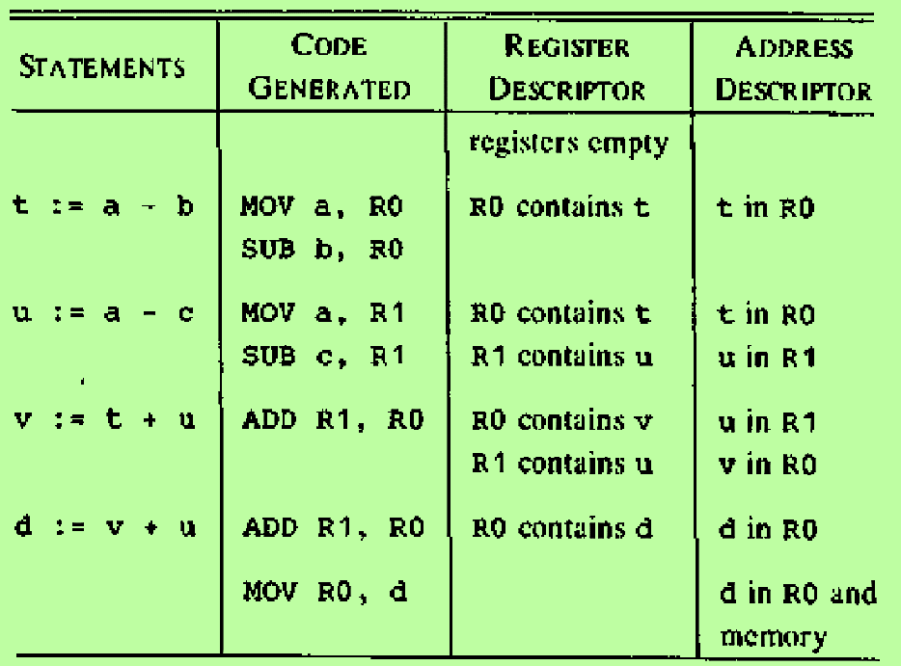
Example 1 : Generating Code of Assignment Statement
Consider the assignment statement
d := ( a – b ) + ( a – c ) + ( a – c )
The three-address code is
t := a – b
u := a – c
v := t + u
d := v + u
The code sequence produced by the code generation algorithm is
Cost of the generated code is 12

Slide 27
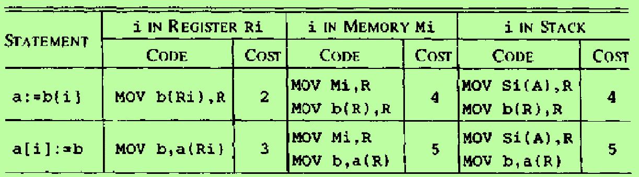
Example 2 : Generating Code of Assignment Statement
Indexed Assignment Statements:
Code sequence generated for the indexed assignment statements
a := b[i] and
a[i] := b
Assuming b is statically allocated
Here the current location of i determines the code sequence. Three cases are covered depending on whether i is in register Ri, whether i is in memory location Mi, or whether i is on the stack at offset Si and the pointer to the activation record for i is in register A

Slide 28
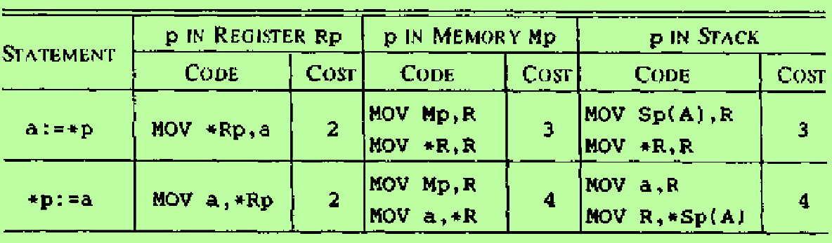
Example 3 : Generating Code of Assignment Statement
Pointer Assignment Statements:
Code sequence generated for the pointer assignment statements
a := *p and
*p := a
Here the current location of p determines the code sequence. Three cases are covered depending on whether p is initially in register Rp, whether p is in memory location Mp, or whether p is on the stack at offset Sp and the pointer to the activation record for p is in register A

